Slide 1


Java ee
(ADVANCE JAVA)
Lecture-49

Slide 2
Today’s Agenda
Introduction To AJAX
Advantages Of AJAX
Introduction To XMLHttpRequest class
Steps In AJAX Programming
Examples

Slide 3
INTRODUCTION
AJAX stands for Asynchronous Java script And Xml
AJAX is not a new language , rather it is a new style of programming made popular by Google in 2007 and today it is the backbone of every dynamic web application.

Slide 4
NEED OF AJAX
When java script was released , it was able to interact with html but it had no way of communicating with the server.
Thus , the only way html page could communicate with a server side script like php or jsp was to make html form containing a submit button and generating get or post request .

Slide 5
NEED OF AJAX
Now , when the user clicks submit button a new page is generated by the server containing the desired results
But , sometimes on slow networks this could take time .
Moreover most of the time the new page has 90% elements same as the previous page only 10% of data gets changed.

Slide 6
SOLUTION
Ajax attempts to remedy this problem by letting our Java script communicate directly with the server, using a special Java script object XMLHttpRequest.
With this object, our Java script can get information from the server without having to load a new page!

Slide 7
STEPS OF AJAX PROGRAMMING
Following are the steps involved in AJAX are :
Create Object for Ajax Request.
Specify a Handler.
Send the request.
Retrieve the data.

Slide 8
CREATING -OBJECT
The first step in AJAX based communication is to create an object of type XMLHttpRequest.
It is a built in class supported by every browser which has some very important properties/methods for generating Ajax request and receiving response.

Slide 9
CODE
<script type=“text/javascript”>
var ajaxreq=new XMLHttpRequest();
.
.
.
.
</script>

Slide 10
SPECIFY HANDLER
When we use AJAX we can’t be sure when the response will come back .
So before we generate the request we must first specify a function to be called when the response comes back from the server.
This function is called “RESPONSE HANDLER”.

Slide 11
SPECIFY HANDLER
Tasks of RESPONSE HANDLER :
Receive the information sent by server.
Extract the data.
Display the result at appropriate place.

Slide 12
SPECIFY HANDLER
Syntax :
ajax.onreadystatechange=<func name>;
The onreadystatechange is the property of the AJAX object which receives a function name as it’s value and every time the readyState property of the AJAX object changes then the function gets executed

Slide 13
THE readyState PROPERTY
The process of communicating with the server begins with sending of the request and finishes when the response comes back .
In between there are many stages involved and these stages are represented using the readyState property

Slide 14
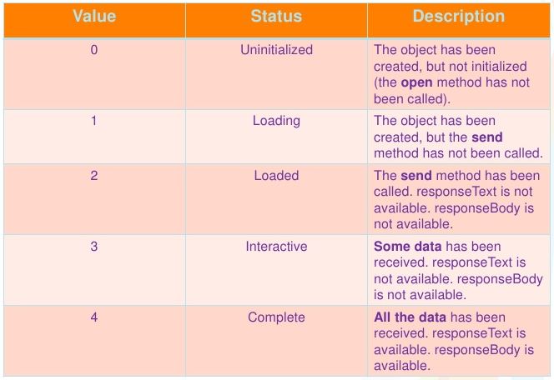
readyState VALUES

Slide 15
THE readyState PROPERTY
Every time the readyState changes the function indicated by the onreadystatechange property gets called.
There are five steps , so function will be called four times
But we are interested in the completed state because the data is only available after the state is 4

Slide 16
THE readyState PROPERTY
function< function name>()
{
if (ajaxreq.readystate==4)
{
// do something with the data
}
}

Slide 17
SEND THE INFORMATION
After we have specified handler we can send request to the server.
This involves 2 steps:
Opening the connection .
Sending the request.

Slide 18
OPENING THE CONNECTION
Before sending the request we need to establish a connection to the server which is done by calling the method open() of the XMLHttpRequest object.
It has the following prototype:
open(method , url , isasynchronous)

Slide 19
OPENING THE CONNECTION
method : The type of method being requested GET or POST
url : URL of the page to request.
isasynchronous: a boolean value indicating whether request will be asynchronous (true) or synchronous(false).

Slide 20
OPENING THE CONNECTION
Sample Call:
ajaxreq.open(“GET” ,”getdetails.jsp?roll=15”,true);

Slide 21
SENDING THE REQUEST
Once we have established the connection to the server we can send request to the server.
To do this we use another method provided by the XMLhttpRequest object called send() which has the following form:
send(parameter);
If we have used “GET” as argument in open() then we pass null as parameter.

Slide 22
SENDING THE REQUEST
Otherwise if we have used “POST” as argument in open() then we have to do 2 things:
Call the setRequestHeader() method passing it “content-type”, “ application/x-www-form-urlencoded” as argument. This tells the server that the data is being sent as a part of request body.
Call send () by passing required parameter as argument.

Slide 23
SAMPLE
So the complete steps will become :
ajaxreq.open(“POST” , “index.jsp” , true);
ajaxreq.setRequestHeader(“content-type” , “application/x-www- form-urlencoded”);
ajaxreq.send(“roll=10”):

Slide 24
RETRIEVE THE DATA
The last step is to receive the response sent by the server .
This done by accessing the property responseText of XMLHttpRequest object

Slide 25
SYNTAX
function <function name> ()
{
If(ajaxreq.readystate==4)
{
var x= ajaxreq.responseText;
//further processing
}
}

Slide 26
EXERCISE 1
Write an AJAX based application to get the date from server and display it on the page.

Slide 27
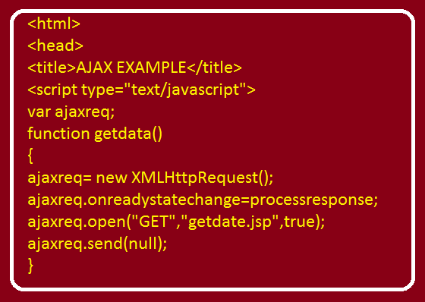
SOLUTION (The html Page)

Slide 28
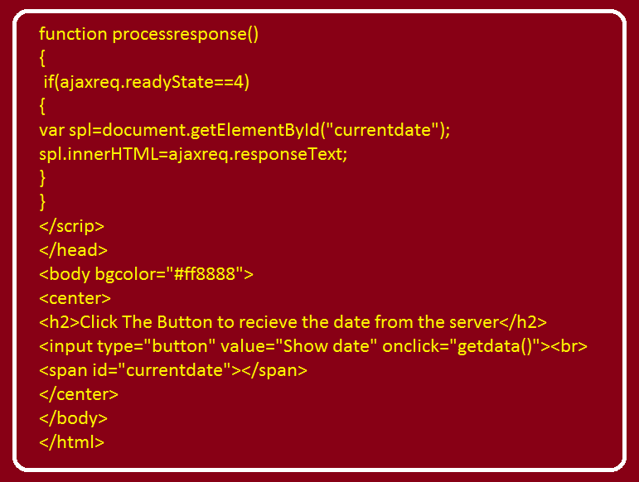
SOLUTION (The html Page)

Slide 29
SOLUTION (The jsp Page)
<%@ page import="java.util.*,java.text.*" %>
<%
Date today=new Date();
SimpleDateFormat sdf=new SimpleDateFormat("dd-MMM-yyyy");
String str=sdf.format(today);
%>
<h3>Date at server is <%= str %></h3>

Slide 30
EXERCISE 2
Write an AJAX based application to accept two nos from the user , send them to the server, receive their sum from the server and display the result on the page.

Slide 31
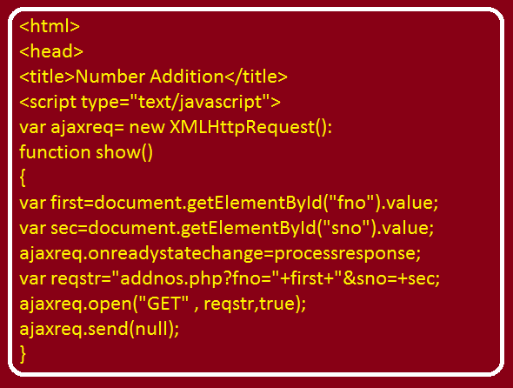
SOLUTION (The html Page)

Slide 32
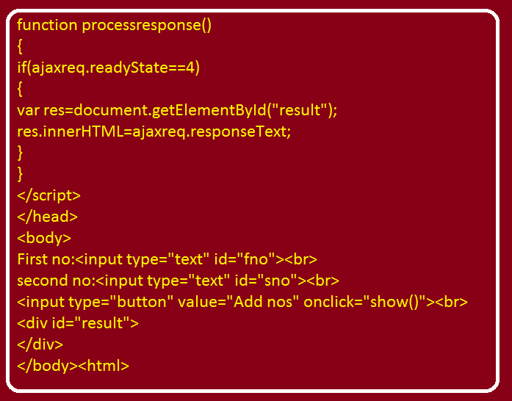
SOLUTION (The html Page)

Slide 33
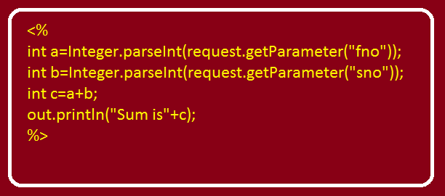
SOLUTION (The jsp Page)

Slide 34
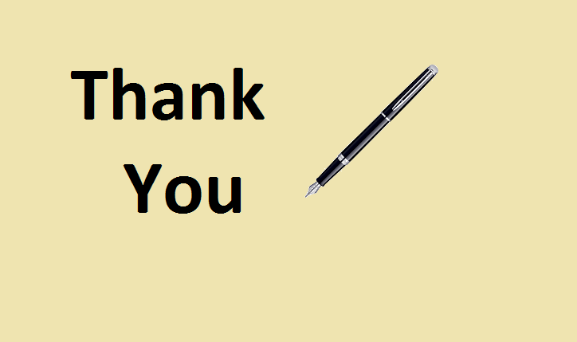
End Of Lecture
For any queries mail us @: scalive4u@gmail.com
Call us @ : 0755-4271659, 7879165533
Agenda for Next Lecture:
Introduction To JQuery
Advantages of JQuery
Downloading JQuery
Syntax Of JQuery

